Slide 1



MUHAMMAD SALMAN
Task Manager Application
Task Management System (Software Dev 02)
Student ID: 0384610
Muhammad.salman10@law.ac.uk
Project Supervisor
Oluwole Ajala

Slide 2
Introduction
Task Manager Application
Add data, Add, Show, Remove, Modify, Exit
Save Data in db.json
Managing tasks, deadlines, and statuses.

Slide 3
Aim & Objective
User-friendly Application
Generates a unique task ID using the UUID library
Flexibility, and clarity.
Add a task
Show all task
Etc.

Slide 4
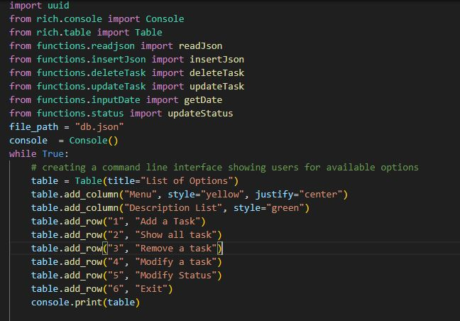
Key Features
Modules and Packages
File Operations
Task Management
User Interaction
Data Structure
Looping Structure
Error Handling
Date Input
Console Output
Graceful Exit Demo Code

Slide 5
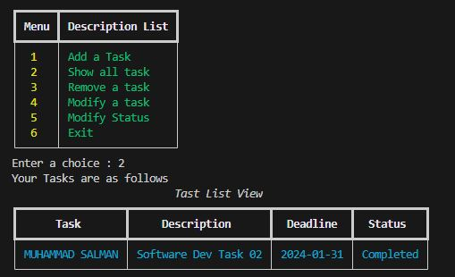
Functionality Overview
Task Addition
Task Viewing
Task Removal
Task Modification
Status Modification
User Interface
User Interface
Error Handling
Date Input (getDate function)
Code Demo

Slide 6
Background Overview
Programming Language and Libraries
File Storage
Data Structure
Looping Structure
Modular Design
User Input Handling

Slide 7
Background Overview
Objective
Error Handling
Functionality Overview
Explanation…

Slide 8

Key Conclusion
User-Friendly Interface
Task Persistence
Modular Design
Rich Formatting
Error Handling
Variety of Operations
Data Structure
Continuous Interaction
Integration of Date Input
Overall Efficiency
https://github.com/itxmsalman

